Slide 1




Agile Software
Development Process
Akashdeep Vasisht

Slide 2

Introduction to Agile Software Development
Definition:
A project is a series of tasks aimed at achieving a specific goal, utilizing knowledge, skills, tools, and techniques to deliver value within a temporary timeframe
Characteristics:
Temporary in nature, with a defined beginning and end date
Examples:
Software development
Events
Backyard fence
Key Issues:
Traditional project management faces challenges like changing requirements, insufficient architecture, and missed release dates
Notes:
A project is defined as a series of tasks with a specific goal, employing knowledge, skills, tools, and techniques to deliver value within a temporary timeframe. Examples, including software development and event organization, illustrate the project's diverse nature. The slide also addresses key issues in traditional project management, such as changing requirements and sequential handovers, emphasizing the challenges faced. This establishes the groundwork for understanding the necessity of an adaptive approach like Agile in software development projects, aligning with the CFO's vision for the grant application project.

Slide 3
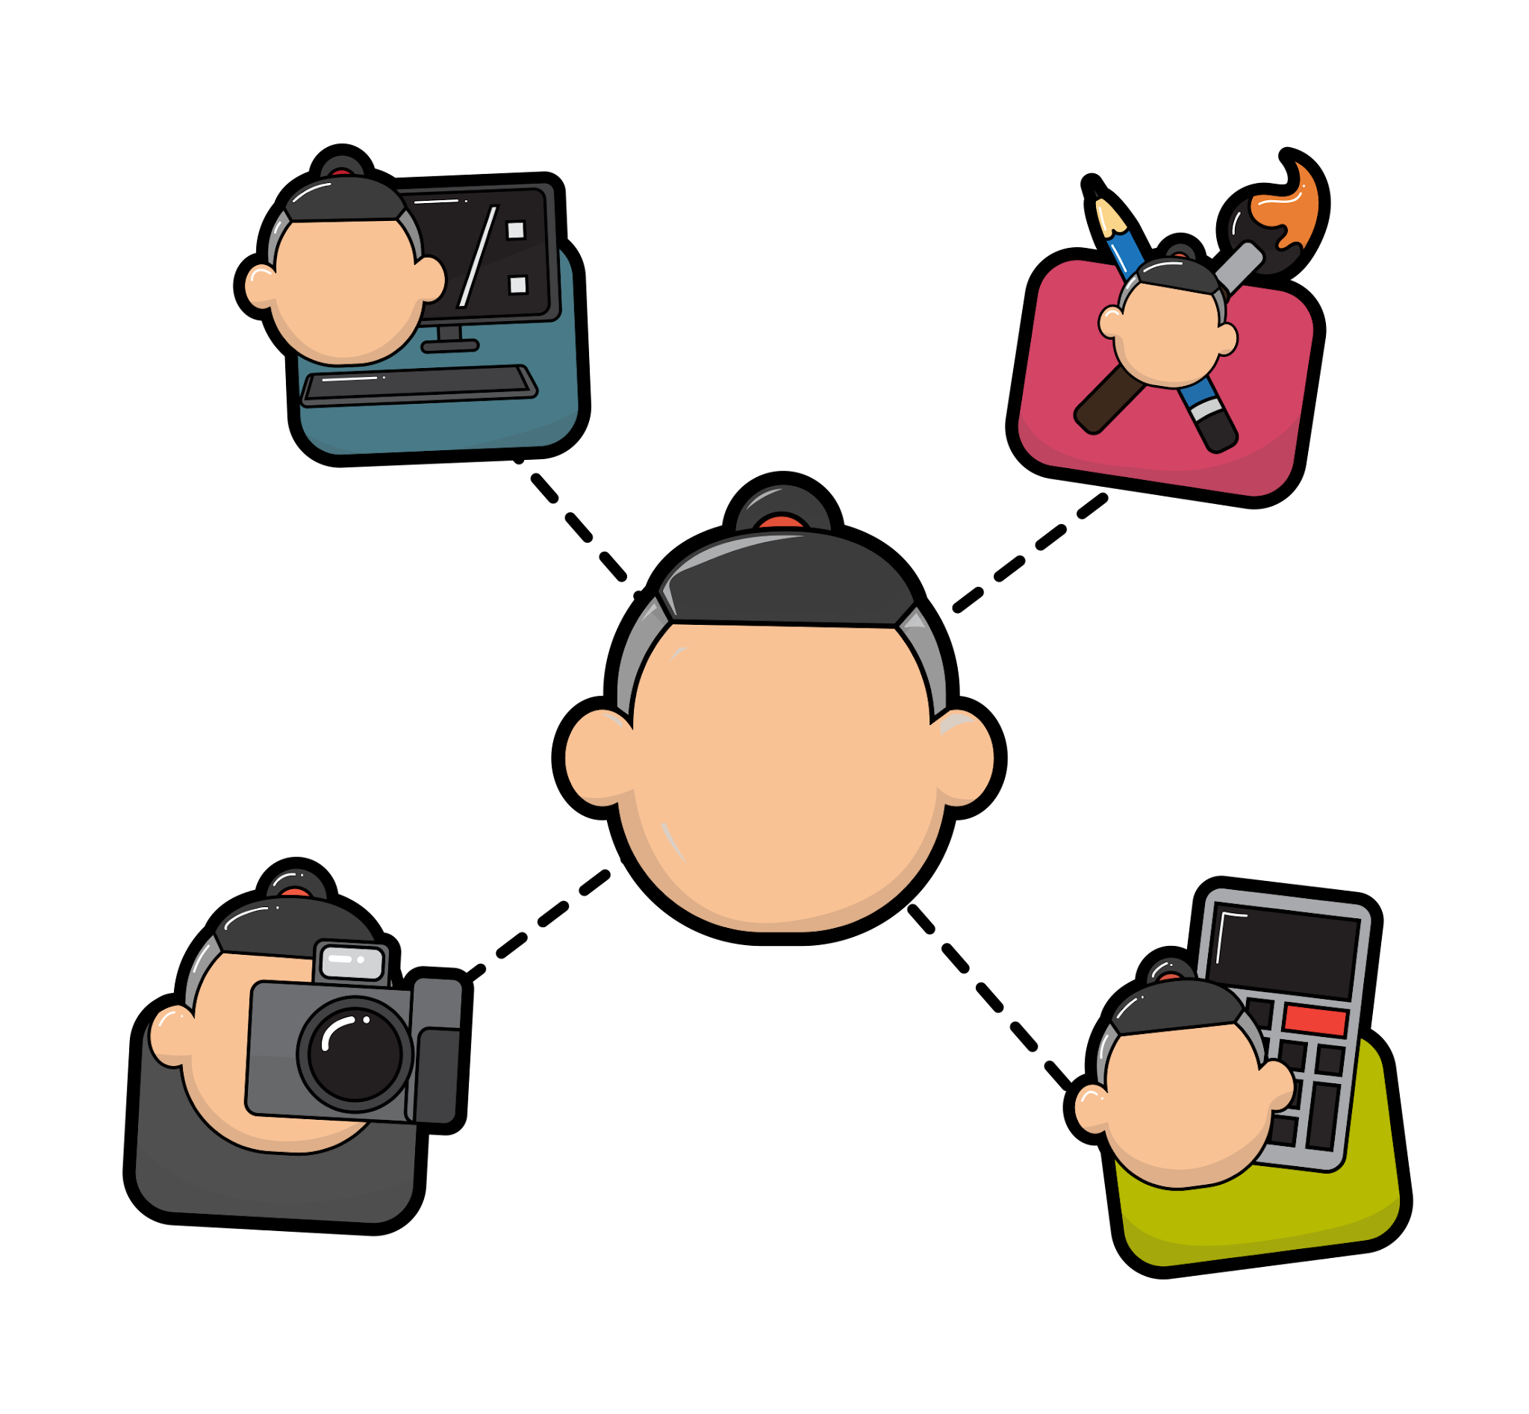
Building Cross-Functional, Collaborative Teams
Cross-Functional Teams:
Comprise individuals from different functional areas, such as developers, testers, UX, and DBAs, ensuring diverse skill sets
Product-Development Team:
Tailored to the product's needs, encompassing skills like database, user documentation, and performance/reliability
Agile Team:
Possesses all necessary skills to complete work, maintains stability within an iteration, and owns its work, fostering commitment and shared goals
Agile Team Roles:
Product owner or customer decides features, while the team is in charge of how work is done, making architectural and design decisions
Notes:
Cross-functional teams encompass individuals with varied skills, from developers to testers, fostering a comprehensive approach. The Product-Development Team adapts to product needs, emphasizing the role of a Product Owner in managing the backlog. Agile Teams, defined by stability and shared goals, empower members to commit to their work and make crucial decisions collectively. Understanding these team dynamics is crucial for implementing Agile successfully in the grant application project.

Slide 4

Building Teamwork with Interpersonal Practices
Interpersonal skills play a crucial role in fostering teamwork and shaping organizational culture
Treating team members as individuals, not just resources, transforms the organizational culture
Agile methodology, being human-centric, relies on strong interpersonal skills for successful product development
Teams require:
Ability to collaborate effectively,
Utilize interpersonal skills
Notes:
Acknowledging team members as individuals rather than resources, this chapter emphasizes the need for a human-centric approach. The Agile methodology, known for its collaborative nature, thrives on effective interpersonal communication and teamwork. As the grant application project advances, understanding and implementing these interpersonal practices will be pivotal for creating a positive and productive team culture.

Slide 5

Agile Requires Different Project Leadership
Agile projects demand effective project management, but the traditional role of a project manager may not align with Agile principles
Enter the concept of servant leadership and the role of an Agile coach to guide teams through the Agile process
Agile project managers and product owners play critical roles in:
Facilitating collaboration
Removing impediments
Ensuring project success
Notes:
While traditional projects may have a project manager dictating tasks, Agile projects thrive on servant leadership and coaching. The responsibilities of Agile project managers, who facilitate the team's processes, and product owners, who prioritize and manage deliverables. As we navigate the grant application project, understanding and adopting these Agile leadership principles will be paramount for project success.

Slide 6

Start Your Agile Project Right
Agile projects are not a continuous, unending process but rather progress through distinct stages – introduction, iterations, and eventually, end-of-life or retirement
Each stage represents a separate project
Emphasizing the need for:
Robust foundation
Effective planning right from the start
Notes:
By breaking down the project into manageable stages, it allows for focused planning and better control over project outcomes. Key elements include the Project Charter, defining the project's purpose and boundaries, creating a clear vision, and establishing release criteria. The chapter emphasizes collaboration within the team, early identification of project type, risk assessment, and the evolving nature of project architecture. By avoiding common traps like Iteration Zero and detailed planning, teams can set the stage for a smooth and Agile project journey.

Slide 7
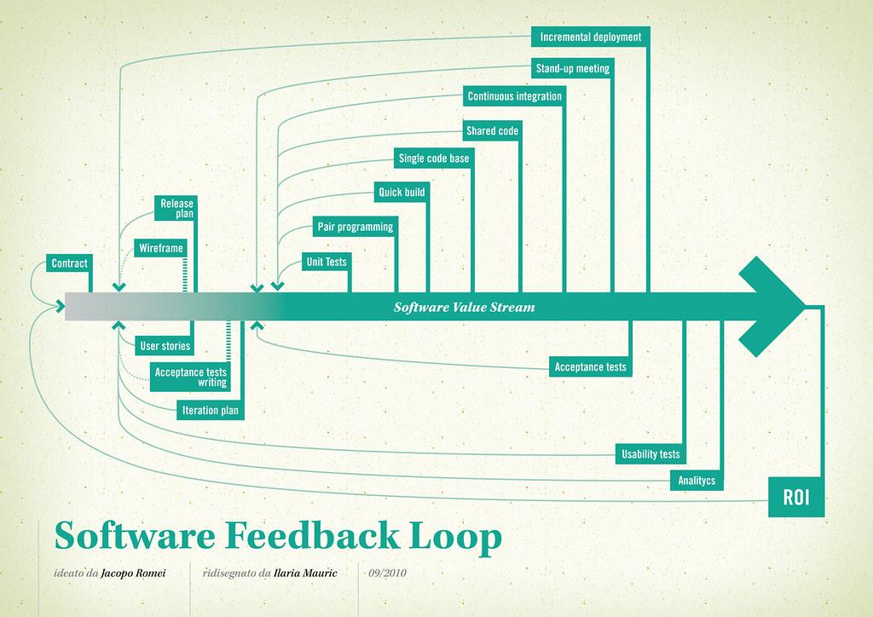
Teams Deliver Features
Traditional projects often encounter problems with:
Prolonged timelines
Misaligned deliverables
Changing requirements
Agile projects, on the other hand, aim to deliver finished features regularly, using a feature-driven development approach
Notes:
The traditional challenges of working on projects for extended periods without delivering tangible outcomes are contrasted with Agile iterative and value-driven approach. Emphasizes the importance of planning, showcasing the roadmap and releases, and delivering value incrementally. We get the concept of a "Walking Skeleton" and the significance of creating Minimum Viable Products (MVP) and Minimum Viable Experiments (MVE). By addressing common pitfalls such as excessive planning and recognizing value traps, Agile teams can optimize their delivery processes.

Slide 8

Rank the Work
Various types of tasks exist in both personal and professional domains, ranging from:
Chores
Work obligations
The process of ranking work involves considering factors like:
Task duration
Interest
Relevance
Notes:
Importance of prioritizing tasks and work items effectively introduces different strategies for ranking work, including tackling the shortest tasks first, choosing the most interesting tasks, and prioritizing the most relevant tasks. The benefits of addressing short work first are highlighted, emphasizing the value of quick wins and visibility into completed tasks. Additionally, the concept of the "Cost of Delay", emphasizing the implications of delaying work on future revenue and overall demand. Also, the significance of valuing learning in the ranking process, advocating for a better understanding of features through small experiments and spikes. Common ranking traps, such as relying solely on estimation or succumbing to external pressures, are addressed to help teams navigate the prioritization process more effectively.

Slide 9
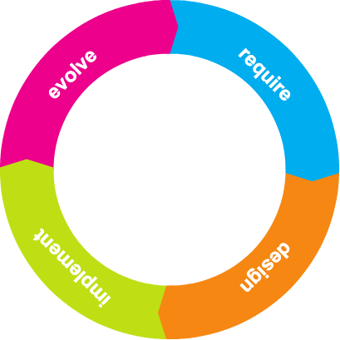
Visualize Your Work with a Board
Project-related questions often arise, such as:
Start dates for specific features
Expected completion times
Task assignments
Various tools can address these questions, including:
Big picture roadmaps for larger deliverables
Shorter roadmaps for near-term plans
Project boards for real-time visibility into the current state of the project
Notes:
Starting with paper boards is recommended, as physically moving cards enforces a more tangible and interactive process. The limitations of electronic tools are discussed, particularly their tendency to reinforce old habits and hinder the creation of smaller stories. The concept of iteration-based boards, such as Scrum boards, is introduced. These boards involve team commitment for each iteration, with columns like "Ready/To Do" and "Today" to manage workflow. Kanban boards, highlighting the significance of WIP (Work In Progress) limits to visualize flow and identify bottlenecks. Practical examples and considerations for creating and managing boards are provided, emphasizing the team's ownership and the need to respect WIP limits to maintain agile practices.

Slide 10

Create Technical Excellence
The pursuit of technical excellence involves a structured approach, akin to preparing a meal where understanding and planning are crucial
Emphasis is placed on:
Optimization, including reading and refactoring code
Early delivery
Working with small stories
Implementing continuous integration (CI) and continuous delivery (CD) practices
Notes:
In the pursuit of technical excellence, a structured approach is essential, much like preparing a meal where understanding and planning play crucial roles. Teams are encouraged to optimize their processes, focusing on reading and refactoring code, embracing early delivery, and working with small stories. Product quality is emphasized, with an early release strategy for small increments of value, learning from feedback, and a gradual shift to defect focus as the product nears mainstream usage. Continuous integration (CI) and continuous delivery (CD) practices are introduced as effective tools for enhancing predictability and obtaining rapid feedback. Working as a whole team is advocated, utilizing practices like pairing, swarming, and mobbing to limit work in progress and foster collaboration.

Slide 11

Agile Estimation: The Good, The Bad, and The Ugly
Problems with Estimation:
Unknown code complexity and typical speed
Uncertainty about technical solutions and unstable team membership
Inexperience in estimation and multitasking on other features or projects
Estimating Stories:
Involvement of the product owner in creating and ranking the backlog
Importance of including everyone in the estimation process
Using story points instead of traditional estimates
Notes:
This slide delves into the nuances of Agile estimation, emphasizing its role in setting realistic expectations for project timelines. The challenges surrounding estimation, such as unknown code complexity and team instability, are highlighted. Estimating stories involves the product owner's role in creating and ranking the backlog, along with the significance of including diverse perspectives from developers, designers, testers, project managers, and product owners. The shift from traditional estimates to story points is introduced, providing a more effective and collaborative approach to estimation.

Slide 12

Know What “Done” Means
Meeting project date or scope commitments
The absence of critical problems allowing the product to ship
Fulfillment of release criteria, marking the project's completion
The project team concludes their work; packaging and release handled by another entity
"Done" in Non-Agile Projects:
Challenges faced in traditional projects, such as demo weeks before project completion and issues leading to a Go/No-Go decision
"Done" in Agile Products:
Criteria for considering a story "done," involving acceptance criteria, unit testing, code review, and product owner acceptance
Notes:
This slide explores the concept of what "done" means in project management, drawing a distinction between non-Agile and Agile approaches. In non-Agile projects, challenges may arise during the demo week or the Go/No-Go decision. In Agile, the focus shifts to specific criteria, including acceptance, unit testing, code review, and product owner approval. Emphasizing the importance of acceptance criteria, working agreements, and iteration completion. The transition to releasing features often and early is introduced, along with considerations for customer preferences and nonfunctional requirements.

Slide 13

Agile Team Measurements
Agile projects enable teams to measure progress and work in progress
Team-based project measures assist in tracking planned and actual work
Key metrics:
WIP (Work in Progress)
Defects
Learn from Measurements/Charts:
Various charts and measurements provide insights into team progress and areas for improvement
Examples include:
Feature or Story Burnups
Iteration Contents
Cumulative Flow
Cycle Time
Defect Escapes
Notes:
This slide introduces the concept of Agile team measurements, emphasizing the importance of tracking progress and work in progress. Highlighting key metrics such as WIP and Defects as crucial indicators for understanding a team's performance. Encouraging teams to learn from different measurement tools, including feature or story burnups, iteration contents, cumulative flow, cycle time, and defect escapes. These metrics offer valuable insights into feature progress, work completed, iteration contents, work in progress, and defect patterns, aiding teams in making informed decisions and continuous improvement.

Slide 14
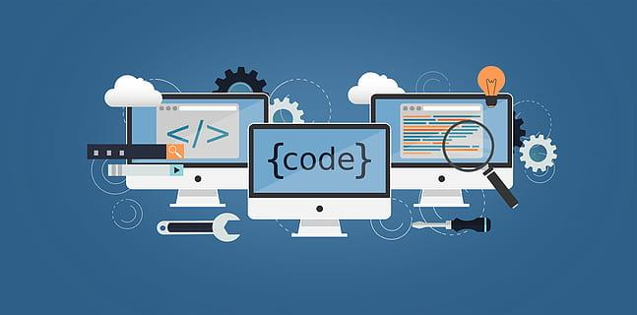
Help Your Meetings Provide Value
Meetings with no value
Examples: Status meetings with no decisions or action items
Agile Meetings:
Retrospectives
Daily Standup
Review of WIP
Demos
Work-planning meetings
Problem-solving meetings
Learning meetings
Notes:
This slide introduces the topic of optimizing meetings for value within Agile teams. Highlighting the common issue of meetings lacking value, particularly in traditional settings with status meetings that lack decisions or action items.Contrasting this with Agile meetings, listing various types such as retrospectives, daily standups, and demos. The goal is to emphasize that Agile meetings are designed to be purposeful, fostering collaboration, decision-making, and continuous improvement.

Slide 15

Report Your Project State
Show Working Product:
Significance to the customer
Emphasis on frequent demos
Example: "Day in the life" scenarios
Show Feature Progress:
Utilize burndown and burnup charts
Display completed features
Present a rolling-wave roadmap
Show Other Requests:
Evaluate multitasking requests
Use a table to illustrate data
Show What is Done but Not Released:
Display Work in Progress (WIP)
Showcase work released internally but not yet live
Notes:
This slide emphasizes the importance of effectively reporting the project state. Covers various strategies to communicate progress to different stakeholders. Encourages showing a working product through demos, using charts for feature progress, and displaying multitasking requests and WIP. Additionally, suggest creating regular status reports and keeping communication channels open through project team websites. The "Traps" warns against pitfalls, such as the misconception of doubling velocity without understanding specific features and the risks of comparing velocities between different teams. Aiming to guide teams in choosing the most suitable ways to communicate project status and progress.

Slide 16
Q&A

